Slide 1
The role of neuronal dynamics in attention perception - investigated with MEG and modelled with Neural Networks

Slide 2
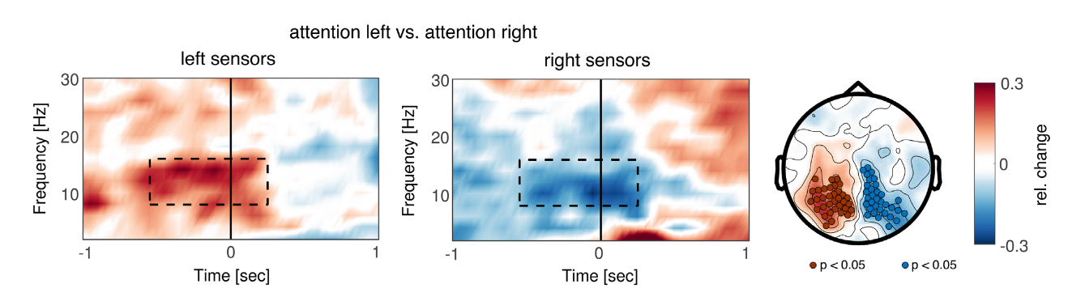
Neuronal alpha oscillations in attention
Neuronal oscillations → rhythmic, synchronized activity of ~10,000 neurons
Reflect fluctuations in neuronal excitability & are associated with formation of neuronal assemblies/networks
Alpha oscillations (8-12 Hz): Functional inhibition

Slide 3
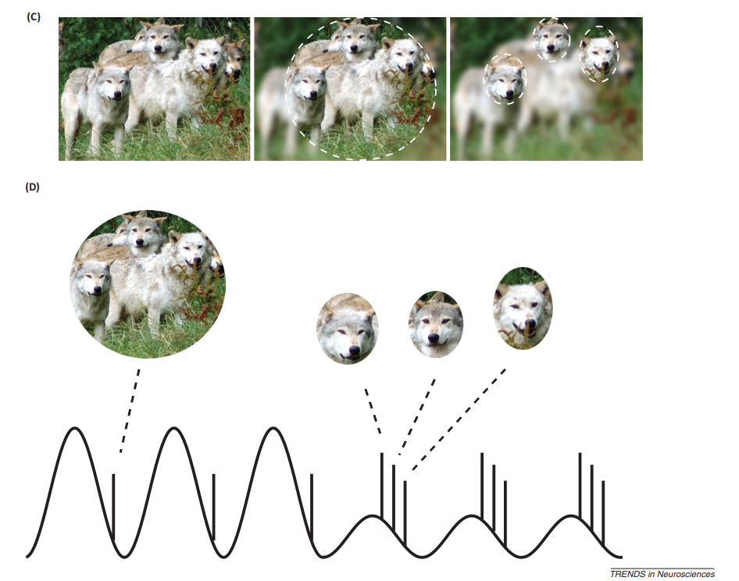
Proposal: alpha oscillations support a pipelining mechanism
Attentional focus: alpha organizes neuronal discharges into a temporal code/pipeline
Low visual attention: high alpha
Discharges of neurons representing objects in scene
adapted from Jensen et al. 2014

Slide 4
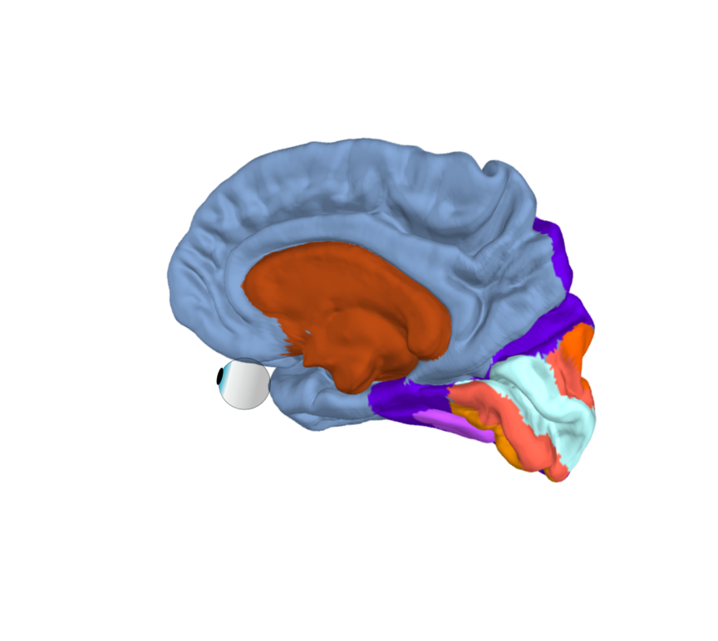
Proposal: alpha oscillations support a pipelining mechanism
Discharges of neurons representing objects in scene
Alpha (8-12 Hz)
High frequency activity/ neuronal discharge
adapted from Jensen et al. 2014

Slide 5
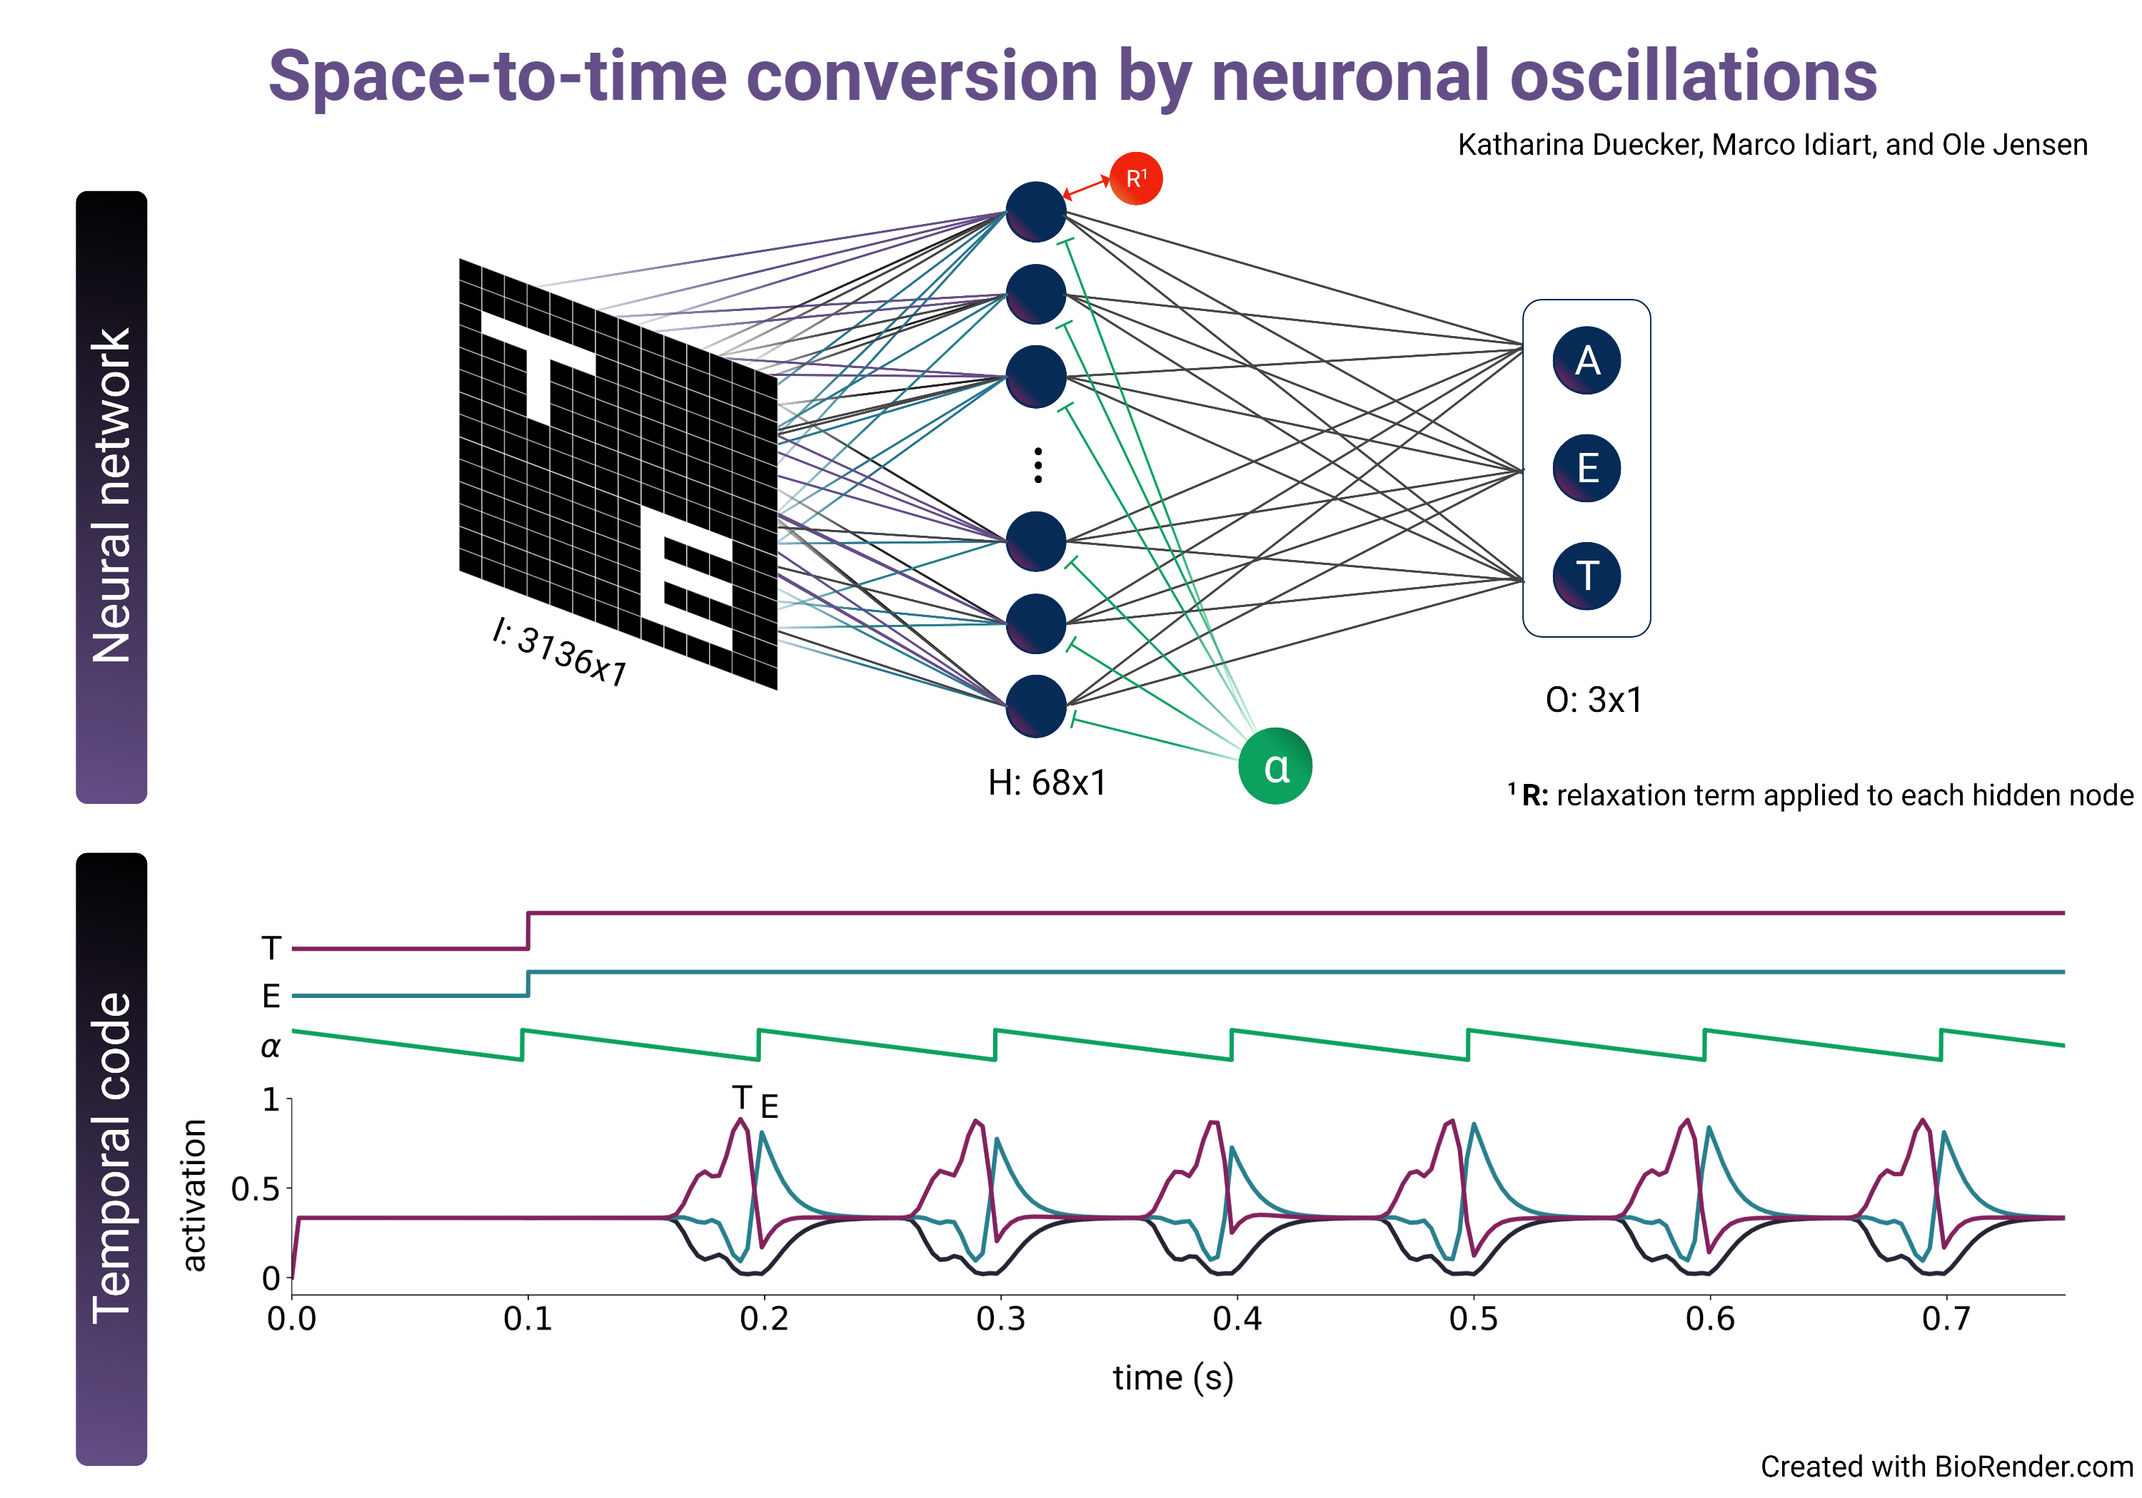
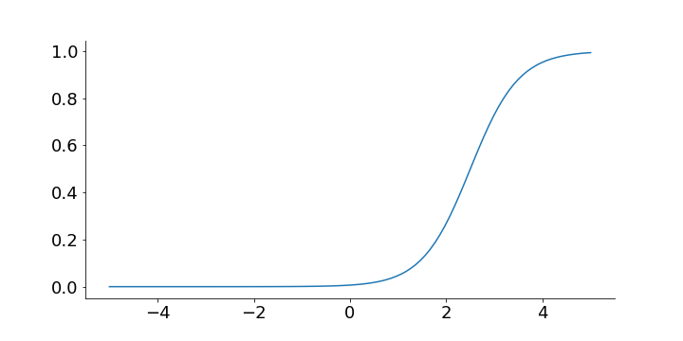

Toy model: space to time conversion by alpha oscillations
Adaptation term: un-sustained activation
θ
$τ_{h}\frac{{δH}_{j}}{δt}=−H_{j}+σ(\frac{\sum{w_{ih}I − θ+}H_{j}}{T}$)
$$τ_{θ}\frac{δθ_{j}}{δt}=−θ_{j}+aH_{j}$$
Weight sharing:
convolutional kernel
sliding over quadrants
I: 56x56
Pulsed inhibition

Slide 6
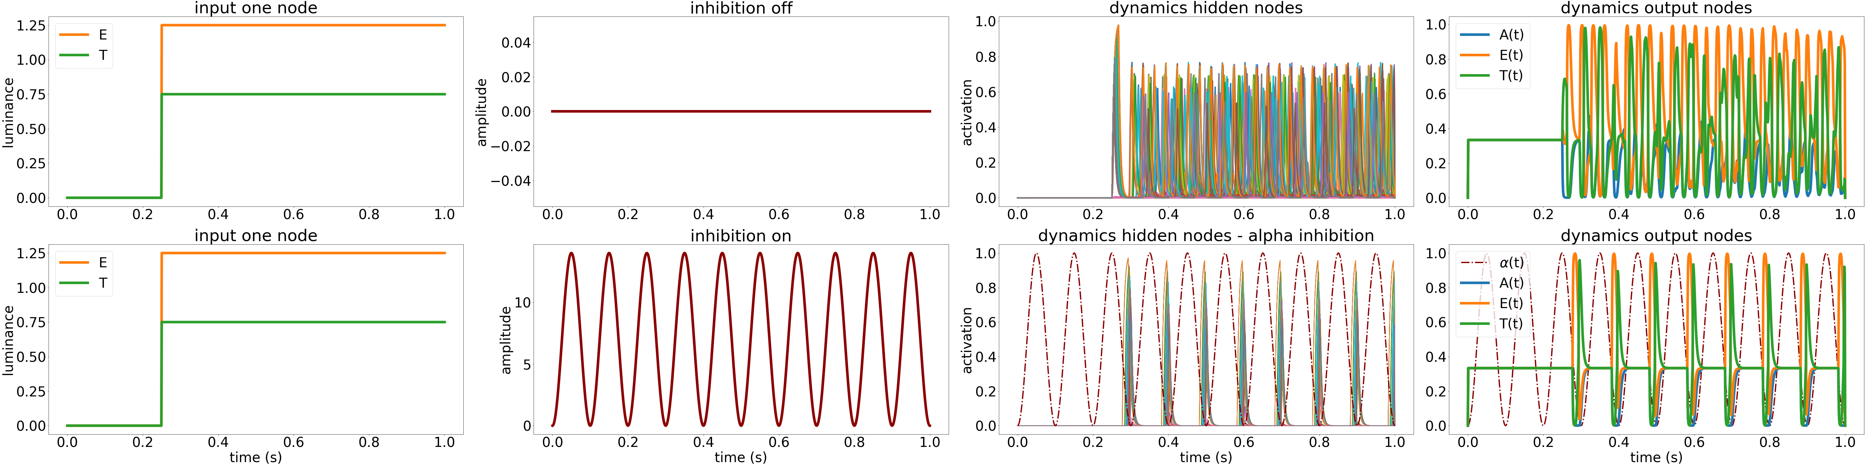
Toy model: space-to-time conversion by alpha oscillations

Slide 7
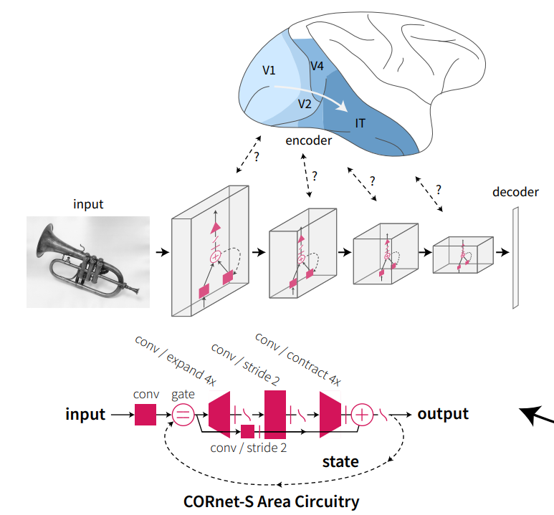
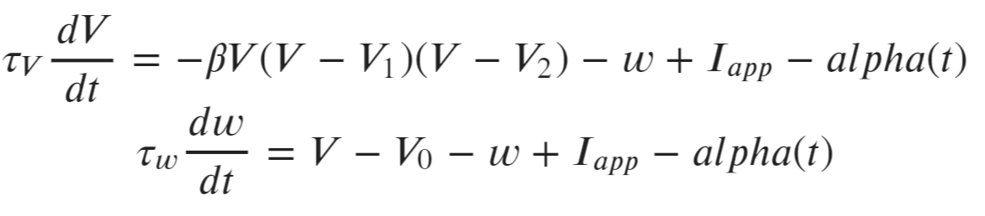
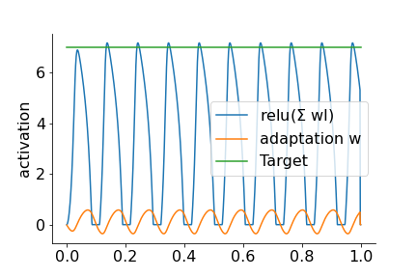
CSHL project: neural dynamics in CORnet-Z
* Fitz-Hugh-Nagumo oscillator
*
I: 224x224
Frozen CORnet-Z architecture
Decoder trained on A,E,T,Z
adapted from Kubilius et al., 2019

Slide 8
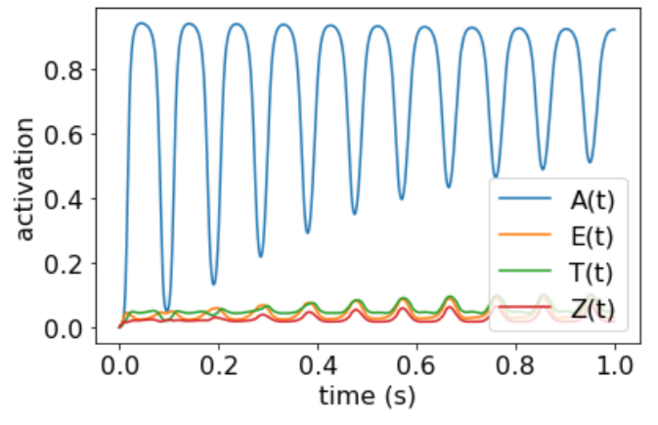
Output activations with dynamics in V1
Alpha amplitude = 0

Slide 9
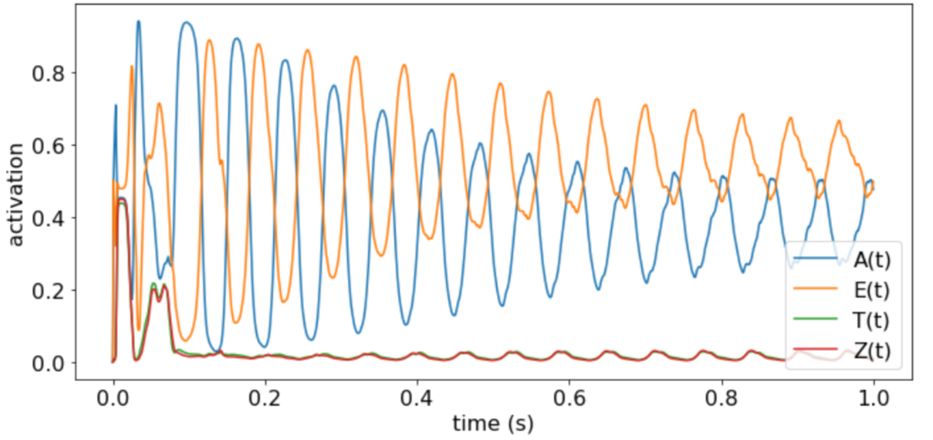
Output activations with dynamics in V1
Alpha amplitude = 0

Slide 10
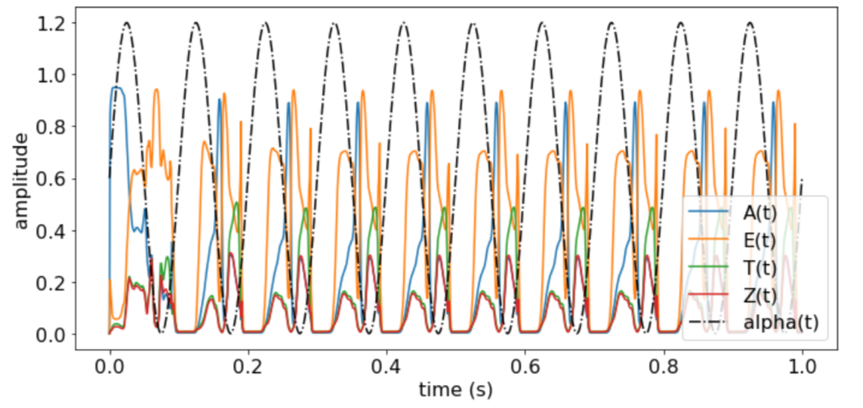
Output activations with dynamics in V1

Slide 11
Output activations with dynamics in V1

Slide 12
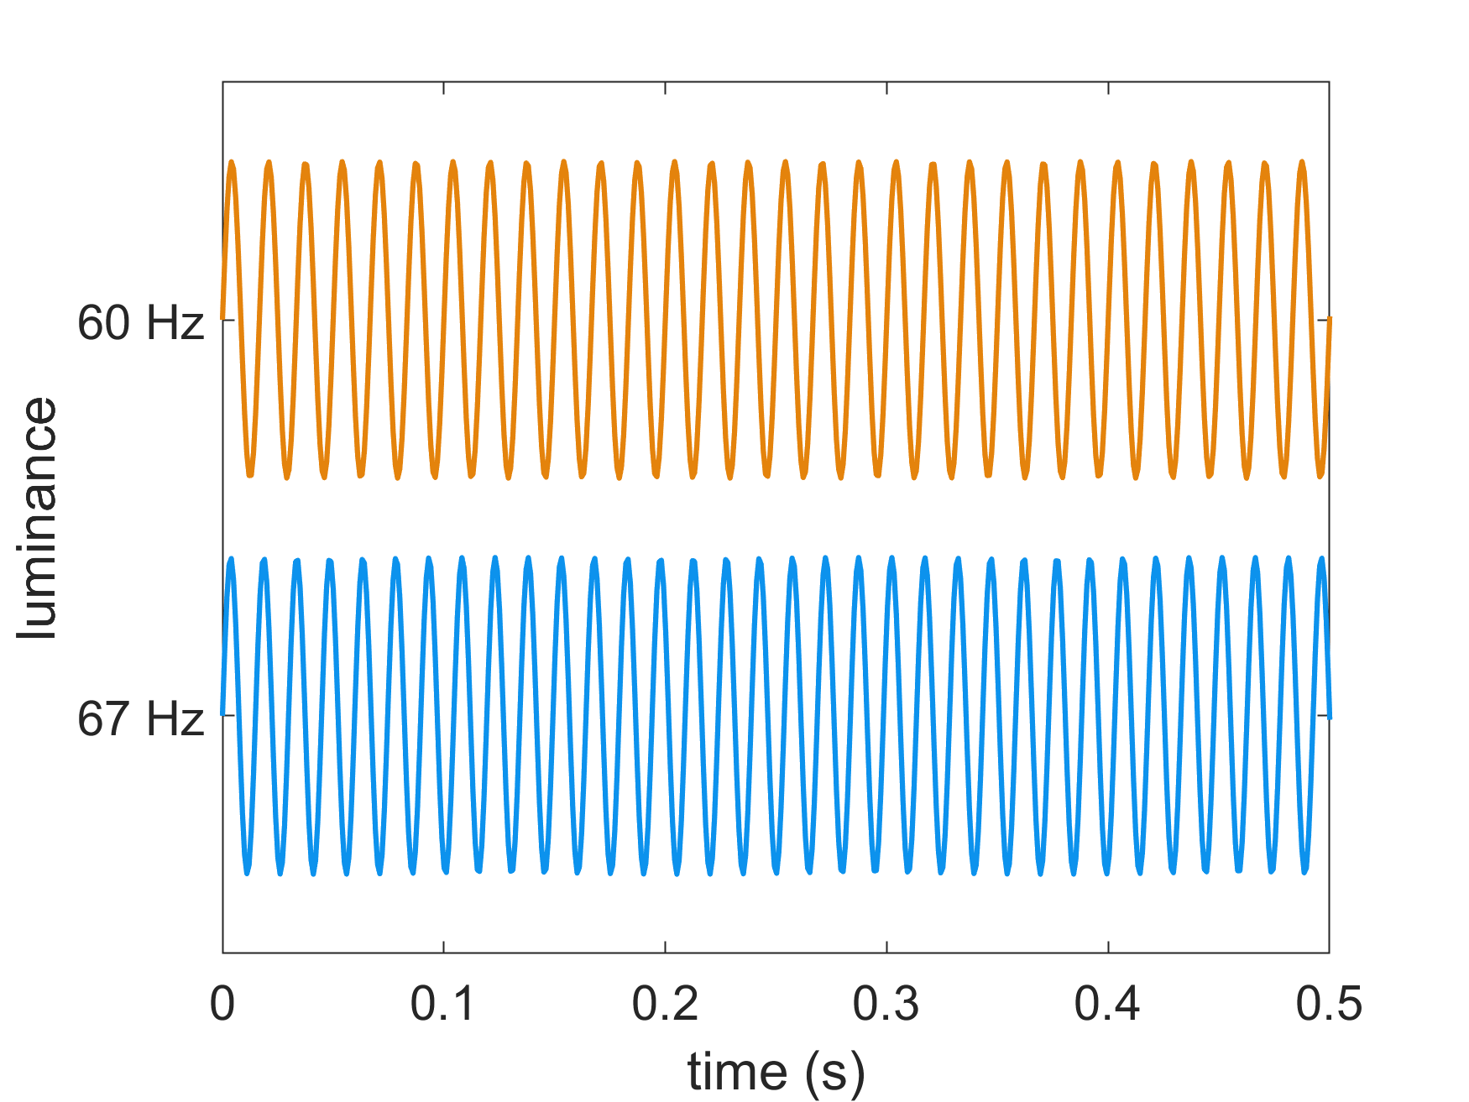
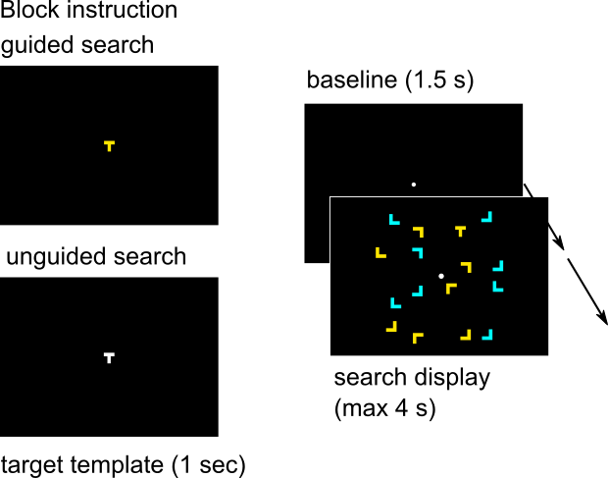
Experimental work: neuronal oscillations & excitability in selective attention
Rapid Frequency Tagging: Measure of neuronal excitability*
* Responses up to 78 Hz, no interference with ongoing neuronal dynamics (Duecker et al., 2021)

Slide 13
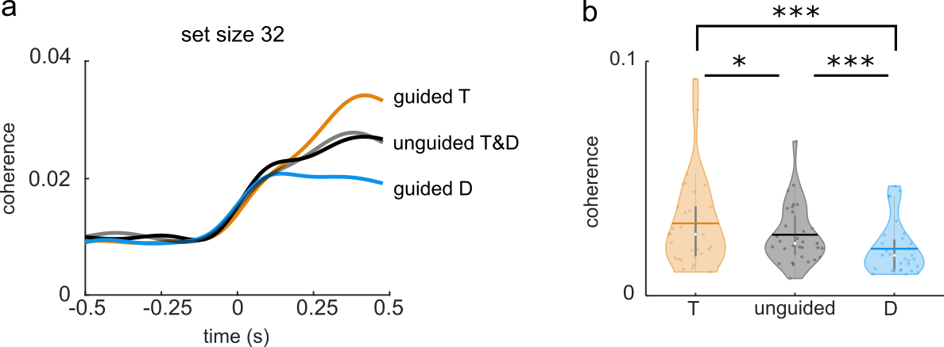
Target boosting & distractor suppression measured by RFT response

Slide 14
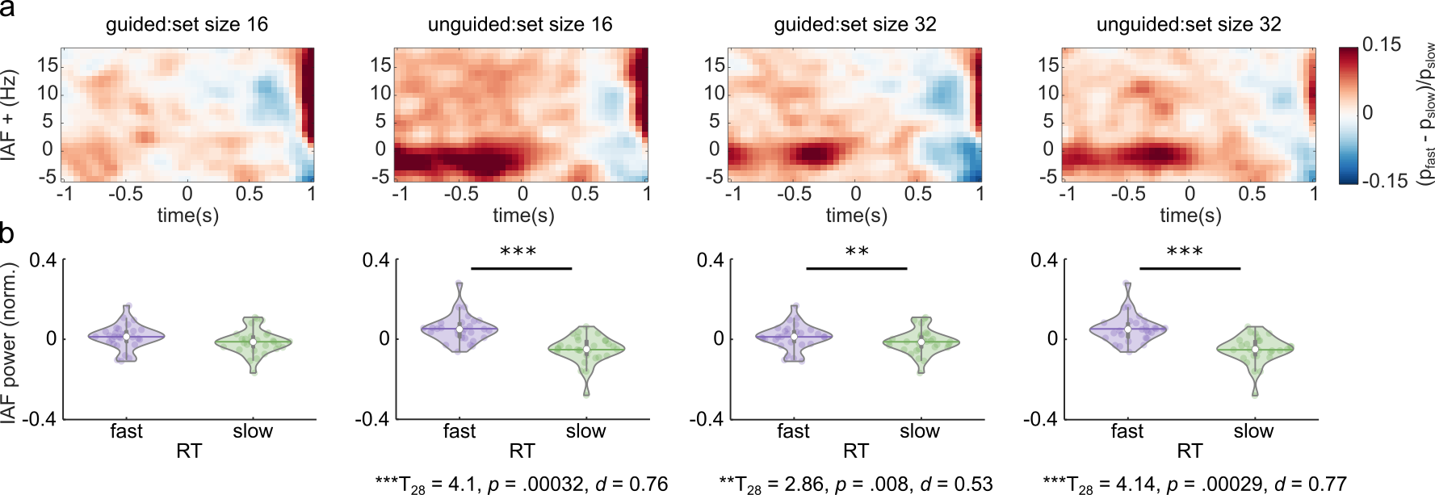
Strong pre-stimulus alpha oscillations -> faster reaction time

Slide 15
Strong pre-stimulus alpha oscillations -> faster reaction time

Slide 16
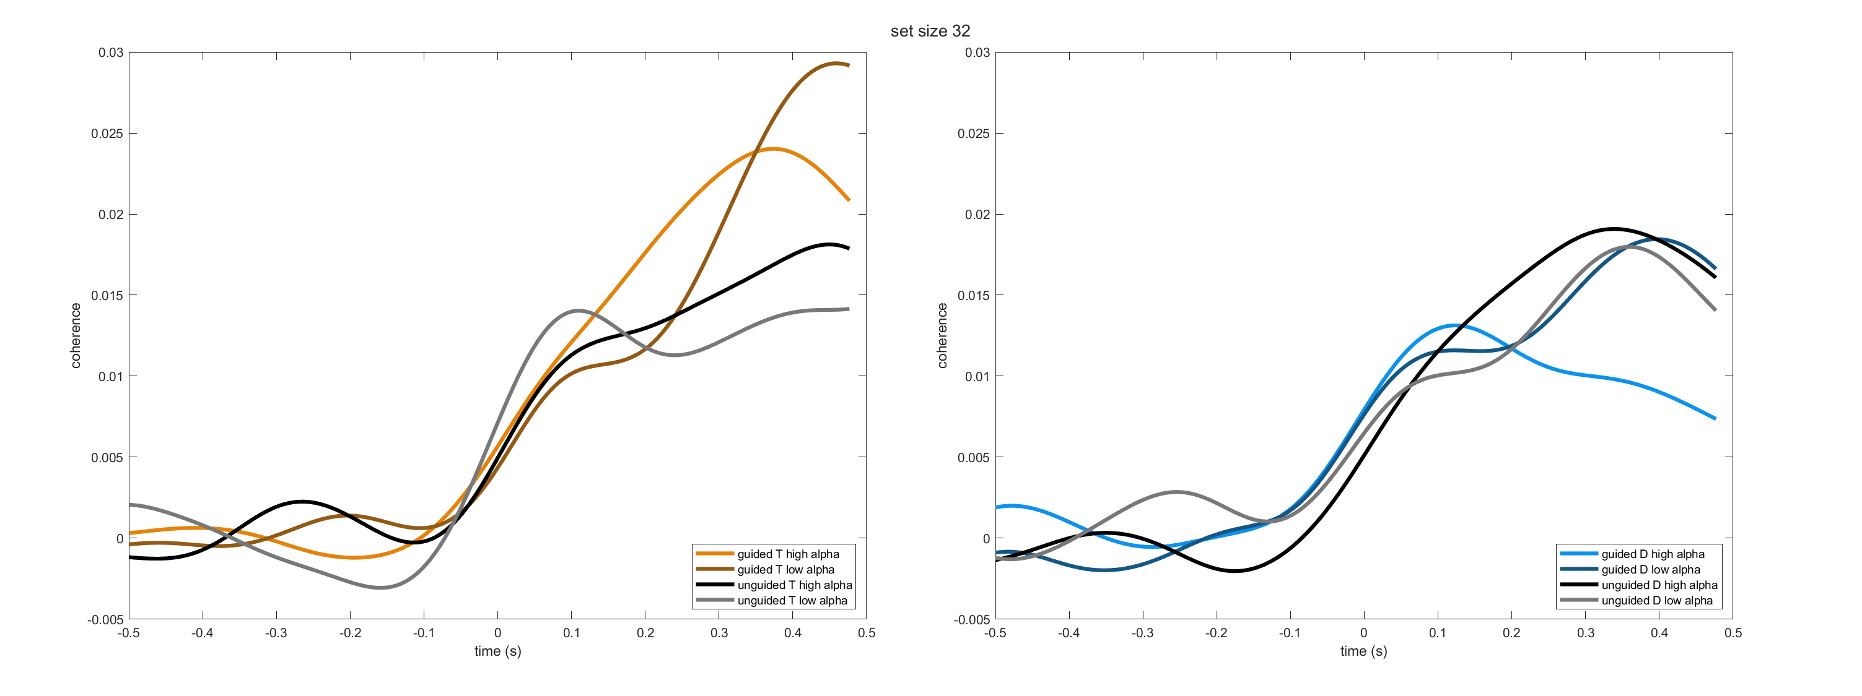
Strong pre-stimulus alpha -> stronger distractor suppression

